Slide 1
How to mobilize private sector investment into low emission infrastructure With an example of the Green Climate Fund as a catalyst
James Falzon, Donald Pols (ECN)
Carmen Arguello (GCF)
Dieu Trinh Nguyen (Govt of Vietnam)
Punta Cana, October 2015

Slide 2
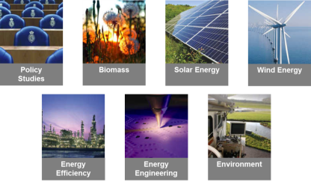
Introduction ECN
ECN Policy Studies
Energy research Centre of the Netherlands since 1955
Research NGO – not for profit
Over 500 staff in seven research areas
60 staff in Policy Studies unit
Main think tank for Dutch government on energy and climate.
Global Sustainability group
Within ECN Policy Studies 15 staff work on issues of ‘global sustainability’ with the mission to help mobilizing public and private investment through low carbon energy policies and measures. Our focus is on four key themes:
Clients include: European Commission, UNFCCC, UNEP, UNDP, CDKN, DFID, GIZ, BMUB, World Bank and the IPCC
Experience working in: a diverse group of countries including Indonesia, Pakistan, Mongolia, Thailand, Ghana, Kenya, South Africa, Kuwait, Argentina, Brazil, Mexico, Colombia, etc.
Policy and strategy development
Increased policy effectiveness
Scoping and prioritisation
Renewable energy deployment

Slide 3
Introduction to the training session
Training objectives
Understand role of private sector in financing low emission infrastructure and financial instruments for mobilizing such participation
Understand the role that the Green Climate Fund (GCF) can play to catalyse this, and how
Overview of training session: 3 parts
PART 1: Why attract private investments to public infrastructure (ECN)
PART 2: the Green Climate Fund as a case study for this (Green Climate Fund, ECN)

Slide 4
Introduction to the training session
Target audience
LEDS generalist that needs to interact with finance experts and facilitate proposal development
At the end of this training participants will be able to
Identify, at a high level, the potential role the private sector can play in low-carbon infrastructure and why
Analyse what kind of instruments are best suited to support private sector investment in such infrastructure
What is needed to develop a proposal for the Green Climate Fund
Presenters
Donald Pols, ECN
James Falzon, ECN
Carmen Arguello, Green Climate Fund
Dieu Trinh, Ministry of Planning and Investment, Vietnam

Slide 5
Part 1: The private sector and low-emission infrastructure: What, why, how? Theoretical perspective
James Falzon, ECN

Slide 6
Mitigation finance framework
In response to a need from practitioners to be able to better frame climate finance, in partnership with GIZ, ECN developed a framework to better understand climate finance flows.
Objective of the framework is to highlight fundamentals in climate instrument selection.
This is the basis for this part of the training - GIZ and ECN exploring how best to share insights.

Slide 7
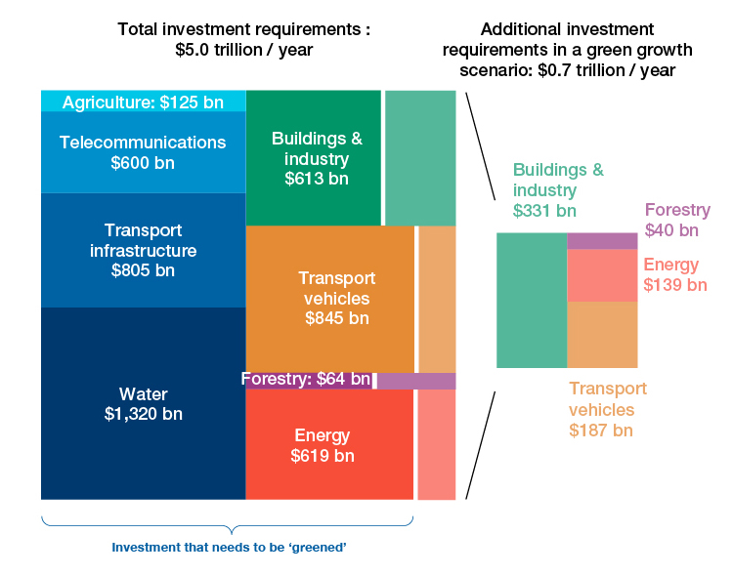
An increase in investments is needed across different sectors, actions
LEDS financing challenge
Source: WEF (2013)

Slide 8
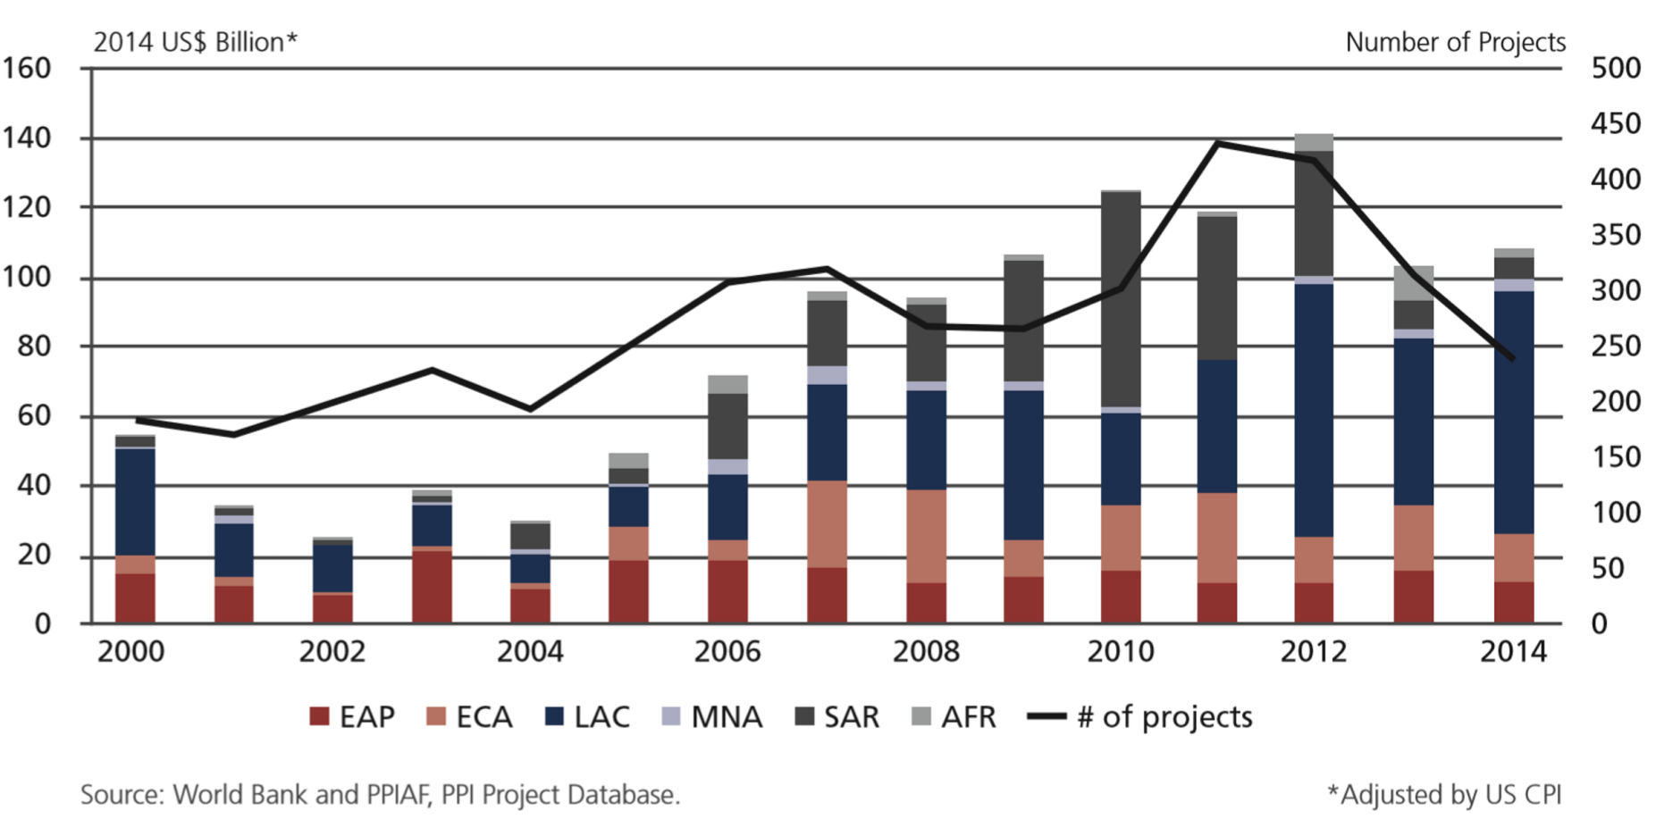
Private involvement in infrastructure: Total investment in energy, transport, and water by region

Slide 9
Why the private sector?

Slide 10
Advantages and disadvantages of Public Private Partnership projects
Advantages
Reduction on public treasury
Value for money
Risk transfer
Output based specification
Performance incentives
Private management skills
Competition
Innovation
Foreign Direct Investment
Time to delivery savings
Improved response to market
Improved costing (sunk costs)
Disadvantages
Higher transaction costs
Higher capital costs
Risk transfer
Insecurities
Inefficiencies
Culture gap
Short term rigidities
Public sector staff concern
Source: Van Herpen(2013)

Slide 11
What is needed to get private sector involved in infrastructure?
Enabling conditions
Project identification, screening, transaction structuring
Policy and institutional framework development
Contracts and procurement
Financial instrument design
Managing and monitoring of the project, compliance, disputes
Public awareness and stakeholder consultation
Activities
Customs (import and export)
Ease of starting, operating, closing a business, including licensing and registration
Labour market (skills & flexibility)
Property entitlements, incl. land
Taxes
Contract set-up and enforcement
Legal institutions, rule of law
Education policies, human & institutional capacities (overlap with business capacity)
Macroeconomic policy framework, political stability
Financial market, access to finance
Infrastructure (energy, transport)
Cluster policies
Targeted research & development policies
International cooperation on low-carbon technology (including tech. transfer and trade policy)
Value chain promotion (including standards and codes)
Source: Stadelmann &Michaelowa 2011

Slide 12
How to maximize the advantage of reducing public budget burden through financial instrument design?
Notes:
The total cost of a mitigation action can have larger or smaller private contributions and correspondingly a higher or lower leverage/efficiency
Efficiency can be thought of as using the minimum amount of public funds to achieve the stated objectives (i.e. at lowest cost to the government). In this case the objective is to implement a mitigation action. Given that for many actions, the overall cost of the action does not depend on the financing strategy (i.e. the cost of a renewable energy investment doesn’t vary, it is the source[s] of finance that vary), the most common approach to a highly efficient action is to utilize public funds to catalyse private investments - so called ‘leveraging of private finance’. The higher the contribution from the private sector, the more efficiently public funds are utilised (Figure 5).
The higher the leverage ratio, the stronger the private sector influence and the
lower the likely financial additionality
National strategies and policies must be respected
Foreign investment entails risks as well as rewards
There are opportunity costs when using limited public investment to leverage private investment
Many approaches transfer risk to public institutions – some risk needs to be shared with private sector
It is important to track results as it is difficult to assess what private investment may have been catalysed
Positive developmental impacts should be present

Slide 13
How to maximize the advantage of reducing public budget burden through financial instrument design?
Highly stylised spectrum of policies/instruments for catalysing private sector investment
In reality the ‘efficiency’ of any approach is context specific
Should also consider effectiveness and feasibility (GCF investment criteria)
Cap. build. and inform
Awareness raising
Regulation
Improved contractual protection
Guarantee
Partial credit guarantee
Support finance
Concessional loan
Support service
Support asset
Subsidy
Tax holiday
Feed in tariff
Partial or full grants
Political risk guarantee
Guidelines
Decision tools
Public equity
Fiscal incentives (depreciation rules)
Technology standards
Targets
Risk cover instruments
Figure: adapted from Lutken 2014
Decreasing leverage of public funds / decreasing efficiency
Notes:
Don’t have time to go into all the details of different instruments, their pros and cons. What I want to leave you with it is the message that some are going to more efficient from the perspective of public funds than others. Where possible, the starting point should be to look for solutions towards the left hand side of this. But if there are more fundamental barriers, or for various reasons these other options are not feasible then need to look at progressively more public involvement.
Consider the case of a renewable technology that is close to viable as an investment for the private sector. One option could be to introduce a FiT or increase an existing FiT, or it could be more cost effective (from the public budget perspective) to address some underlying financing costs or other risks.

Slide 14
Appropriate instrument selection for a specific context: Feasibility and effectiveness
Private sector and LEDS
Country investment grade
AAA
C
Current private sector participation
HIGH
NONE
Political willingness
HIGH
MEDIUM
Potential profits
IRR > 20%
IRR < 5%
Risks
LOW
HIGH
Cap. build. and inform
Regulation
Guarantee
Support finance
Support service
Support asset
Notes:
Coutnry investment grade
Particiaption private sector
Political willingness
Profit potential
Risks

Slide 15
Example of effectiveness: Geothermal in Kenya
Private sector and LEDS
Country investment grade
AAA
C
Current private sector participation
HIGH
NONE
Political willingness
HIGH
MEDIUM
Potential profits
IRR > 20%
IRR < 5%
Risks
LOW
HIGH
Cap. build. and inform
Regulation
Guarantee
Support finance
Support service
Support asset
Notes:
Coutnry investment grade - http://www.tradingeconomics.com/kenya/rating
Particiaption private sector
Political willingness
Profit potential
Risks

Slide 16
Example of feasibility: UK Onshore Wind…. Before
Private sector and LEDS
Country investment grade
AAA
C
Current private sector participation
HIGH
NONE
Political willingness
HIGH
MEDIUM
Potential profits
IRR > 20%
IRR < 5%
Risks
LOW
HIGH
Cap. build. and inform
Regulation
Guarantee
Support finance
Support service
Support asset
Notes:
Coutnry investment grade - http://www.tradingeconomics.com/kenya/rating
Particiaption private sector
Political willingness
Profit potential
Risks

Slide 17
Example of feasibility: UK Onshore Wind…. After
Private sector and LEDS
Country investment grade
AAA
C
Current private sector participation
HIGH
NONE
Political willingness
HIGH
MEDIUM
Potential profits
IRR > 20%
IRR < 5%
Risks
LOW
HIGH
Cap. build. and inform
Regulation
Guarantee
Support finance
Support service
Support asset
Notes:
Coutnry investment grade - http://www.tradingeconomics.com/kenya/rating
Particiaption private sector
Political willingness
Profit potential
Risks

Slide 18
Exercise instructions
Use the diagram as a basis for discussion of the range of instruments to support private investment for low-emission infrastructure in a specific sector in a country of your choice
Note down the different challenges / uncertainties you face in doing so
For example, to understand what instruments are on the table, you might need expert advice
Where are the biggest uncertainties?
What is good practice?
Time available – 15 minutes

Slide 19
Private investment in infrastructure: Shifting investment patterns
Private investments illustrated earlier are not necessarily low-carbon.
How can we shift patterns of investment?
Lots of different financing sources!
GCF can act as a catalyst:
Shifting existing investment patterns towards low-emission, climate resilient investments, by making these investments more attractive than other kinds of investments.
Increasing the pool of capital available such that low-emission, climate resilient projects, which often require more up-front capital, can be fully rolled-out (closing the gap)
In order to do so, different financial instruments will be utilized.

Slide 20
Survey of accredited entities
In response to demand from LEDS-GP members, the Finance Working Group / ECN studied GCF documentation, and undertook interviews with accredited entities.
Provided insights on:
GCF process
Instruments
Short and long term priorities of GCF (from their understanding)
Pipeline development
Here we share insights on instruments.

Slide 21
Instruments of the GCF to leverage private investment
How is the finance structured?
Short term
Grants (mitigation and adaptation)
Concessional loans
Green project bond guarantees
Equity Instruments
Results based finance
Medium and long term
Green bond direct issues
De-risk instruments
Commercial paper (promissory note with a fixed maturity, usually less than one year)
Syndications and club deals (group of lenders to one single borrower)
Private placement programs (intermediate step between bonds / commercial paper (securities) and syndicated loans (loan instrument)
Source: Bachus et. Al (2015)

Slide 22
Indicative GCF priorities on instruments and implications for size of request
The GCF
Up to 200 million USD
Up to 20 – 40 million USD
Up to 10 - 15 million USD
Cap. build. and inform
Regulation
Guarantee
Support finance
Support service
Support asset
Lowest
Moderate
Highest
Moderate
Lowest
Notes:
As GCF needs to be sustainable, assumed that supporting finance has the highest priority
Larger disbursements will be made here

Slide 23
Example 1: Blended concessional finance
How could the finance structured?
Source: GCF (2014)
Notes:
Not the only source of funding!

Slide 24
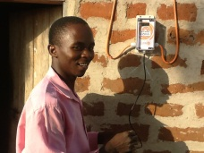
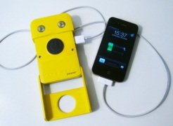
Example 2: Fund for innovative energy companies in East Africa
How could the finance structured?
Bank as an accredited entity and lead organiser
Would like to set up fund for on-lending to innovative energy companies in East Africa
Approximate 50 million USD application as pilot phase from the GCF
Will on-lend to private companies
Capital: Equity + Concessional loan on-lent
Concessional loan
Loan repayments (lower interest rate)
Loan repayments (higher interest rate)
Source: ECN (2015)

Slide 25
Example 3: Green bonds
How could the finance structured?
GCF initially will not be able to issue green bonds itself
Could guarantee intermediaries issuance
Long-term, it may be possible for GCF to issue its own bonds
Investors
Capital
Repayments
Capital: Equity + Concessional loan on-lent
Guarantee
Loan repayments (higher interest rate)
Green bond issuance: e.g. World Bank, with JP Morgan, Goldman Sachs as managers
Source: ECN (2015)

Slide 26
Key messages
Investment challenge for LEDS is enormous
Private sector can play a role in bridging the gap
There are many things that need to be addressed to attract private investment
Focusing on maximizing leverage and efficiency, a variety of instruments can be employed, and context, effectiveness and feasibility are important constraints
The GCF can help catalyze these efforts by supporting specific financial instruments
From a volume perspective, most of the finance will be channeled through concessional finance
But other instruments are on the table – just need to remember to match your project funding request with what the fund is likely consider to reasonable!

Slide 27
Thank you for your attention. Questions?

Slide 28
Part 2: GCF deep dive
Carmen Arguello (GCF)
Country experience – Vietnam

Slide 30
What kind of actions are needed? Vietnam experience
Getting to a bankable proposal
Strategic Plan to Access GCF
Enhance Institutional Mechanism Take into consideration: GCF Readiness Programme (Standard Package) -> prepare ‘readiness proposal’. TA support from DPs (UNDP, GIZ, KfW, KOICA, etc) 1. Conduct NIEs (line ministries, SBV, VDB, commercial banks, environmental/CC/GG funds) & NDA assessment -> select potential NIEs & design capacity building for NDA & potential NIEs & GCF focal point from line ministries. 2. Identify key stakeholders from VN & organise consultation workshop with all key stakeholders from Gov & MIEs/IEs 3. Design a special mechanism for GCF in Vietnam to accelerate timeline for the national internal process & gain higher effectiveness of the proposed projects/programmes. (i.e. in VN, MPI/NDA has carefully consider how to make GCF procedures takes less time than ODA project, GEF procedure. | Select & Develop Investment Proposal 2015-2016 via accredited MIEs/IEs Coordination skill to harmonise work/choose appropriate work for all/each of the MIEs/IEs 1. Cooperate with MIEs/NIEs to select & conduct potential proposal: In the period 2015-2016: Selection of accredited MIEs, i.e. UNDP, KfW, AFD, ADB …; & potential MIEs interested in GCF, i.e GIZ, KOICA,… Fit with the sectors of priority of MIEs; Fit with the procedures for appraising, bidding, Monitoring and Evaluation (M&E); Can act as Co-sponsor. In the period after 2016: Can select MIEs or NIEs 2. Procedure: UNDP, KfW, AfD, ADB (VGGSF, VDB and other after 2015) to screen and then forward to MPI; Some important criteria for selection: Both adaption and mitigation; Involvement of private sector; High socio-economic impact: consider beneficiaries, i.e. the poor (projects supporting agricultural production, agricultural product processing…), gender equality issues; In line with priorities/requirements of GCF, National Strategy & MIEs/IEs. MPI and Vietnam GCF Steering Committee to screen; MPI reports to Prime Minister for approval; MPI informs UNDP, KfW, AFD, ADB for improvement of the proposals 3. Communication with GCF: Inform to GCF about the proposal: both MIEs/IEs (UNDP, KfW, AFD, ADB) & MPI; Strategic communication plan with GCF.
NDA | Potential NIE | Vietnam GCF Steering Committee/VN GCF SC
Central level | Region | Province | Private Sec.
Climate Finance Task Force under MPI Assist the VN GCF SC in directing and organising the implementation of the rights and obligations of the Vietnam NDA in implementing the international cooperation activities with GCF and its activities in VN coordinating and implementing activities of GCF in VN and other international financial mechanisms about the CC - GG under MPI mandates
Vietnam Developm-ent Bank (VDB) | Vietnam Green Growth Strategy Facility (VGGSF)
MPI Vice Minister Director General of DSENRE, MPI | Office of the Gov. /OOG | Line minis-tries (MOF, MARD, MOIT, MOC, MOIT) | SBV (develop green credit line & capacity building for pilot comer-cial banks) | Vietnam chamber of commerce & industry (rep. for private sector)
Screen list of project/programme proposed by Line Ministries, SBV (collecting from commercial banks). Renewable energy Energy efficiency (sub-sector) | 1. Mekong Delta: 2. Red River Delta | Mainstream with activity in Provincial GGAP supported by MPI/ KOICA. | Focus on SOE (considered as private bus in VN) & SME. VideBridge (slide 23-24) - Commercial banks

Slide 31
What kind of actions are needed? Vietnam experience
Getting to a bankable proposal
Challenges
Funds mobilisation
Funding and Disbursement Management
Monitoring and Reporting
Transparent, valid, simple and effective procedures
Promoting participation from private sector (which currently has limited capacity, awareness)
A transitional phase is normally experienced before being officially implemented.
Specific challenge to convice private sector (especially business enterprise): many procedures/unwieldy mechanism + long time to wait for decision of investment; possibility of not being chosen for investment; while business enterprise (to attract GCF, this should be top medium-sized enterprise in VN) always looks for quick process, also has the ability to borrow from other funding despite of higher interest.

Slide 32
Closing discussion
Donald Pols, ECN

Slide 33
Plenary discussion
Exercise
What are your experiences in developing a proposal?
What are the most important activities?
What are the biggest bottlenecks?
What are good practices that you can shared with colleagues?
Where do you think private sector could come in?
What kind of support would be most useful?

Slide 34
Support for your efforts to mobilize private investment, and accessing the GCF
Existing GCF readiness support:
Strengthening NDA and focal point
Strategic framework (country programme for engagement, and strategic investment priorities)
Accreditation of implementing entities
Pipeline development
Information and experience sharing
LEDS-GP FWG is considering to develop:
Knowledge products (guides, meta-guides [i.e. overview of available guides])
Ad-hoc small-scale technical assistance across different activities needed to prepare a proposal (already available)
Matchmaking with accredited entities, GCF, NDAs
Support to look for funding for readiness and proposal development

Slide 35
Thank you for your attention
James Falzon (falzon@ecn.nl)
Donald Pols (pols@ecn.nl)
Carmen Arguello (carguello@gcfund.org)

